Slide 1
Network Monitor Application
Linzhe Li, Feiyi Xu

Slide 2
Target: Enterprise network
Monitor network traffic
Feedback network quality
Assist network administrator to do troubleshooting

Slide 3



Our approach
Monitor network performance between Purdue and most popular Webserver around the world
Get instant alerts when one or more paths may suffering low network quality
Visualize delay, time to live, and loss rate of each link on a dynamic graph and figure out where may the problem

Slide 4


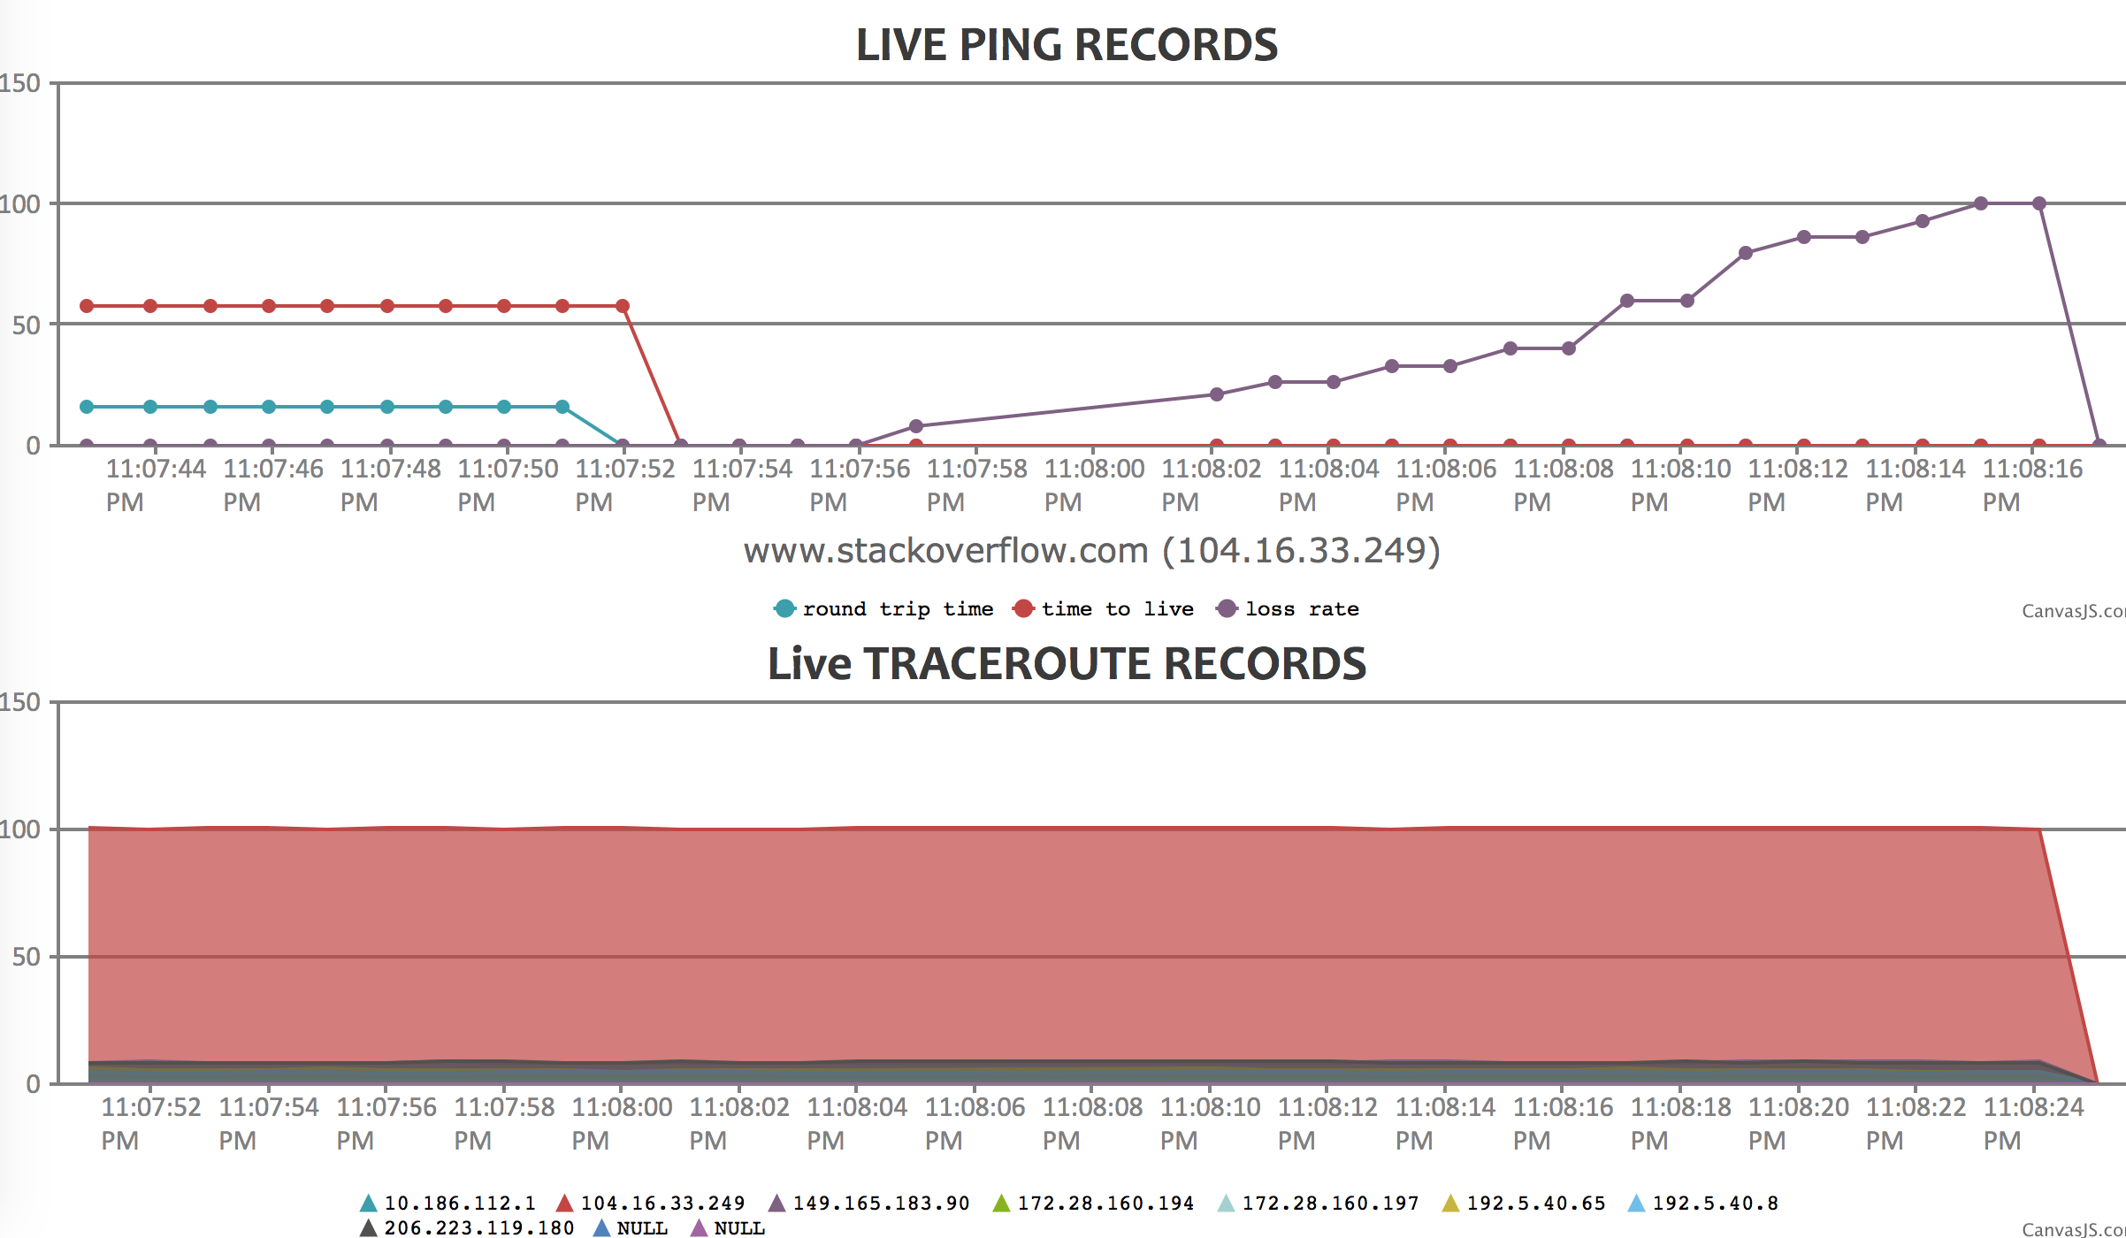

Producer
Consumer
Ping / TraceRoute

Slide 5
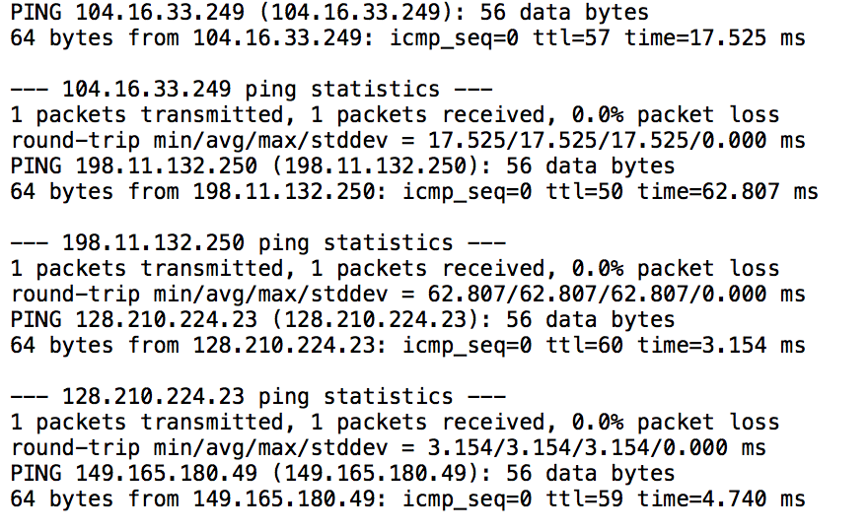
Producer:
source.cpp – Ping and Traceroute bunch of webserver , and get ping and traceroute log. Sent those log file out through TCP
Fig 1: ping log file

Slide 6
Consumer:
network_monitor.py – Python code that submitted to Spark Streaming. The main purpose is to process incoming information to desired format.
control.cpp – C++ based code that reading the processed results from spark streaming. It can point out which link may has potential problem, then, generates a .json file that contain round trip time, time to live, and loss rate of the problematic link for CanvasJS.
chart.html – A web that includes CanvasJS library. Programming in Java Script that can generate dynamic chart to visualize round trip time, loss rate, time to love, and route trip time along the path of the problematic link.

Slide 7
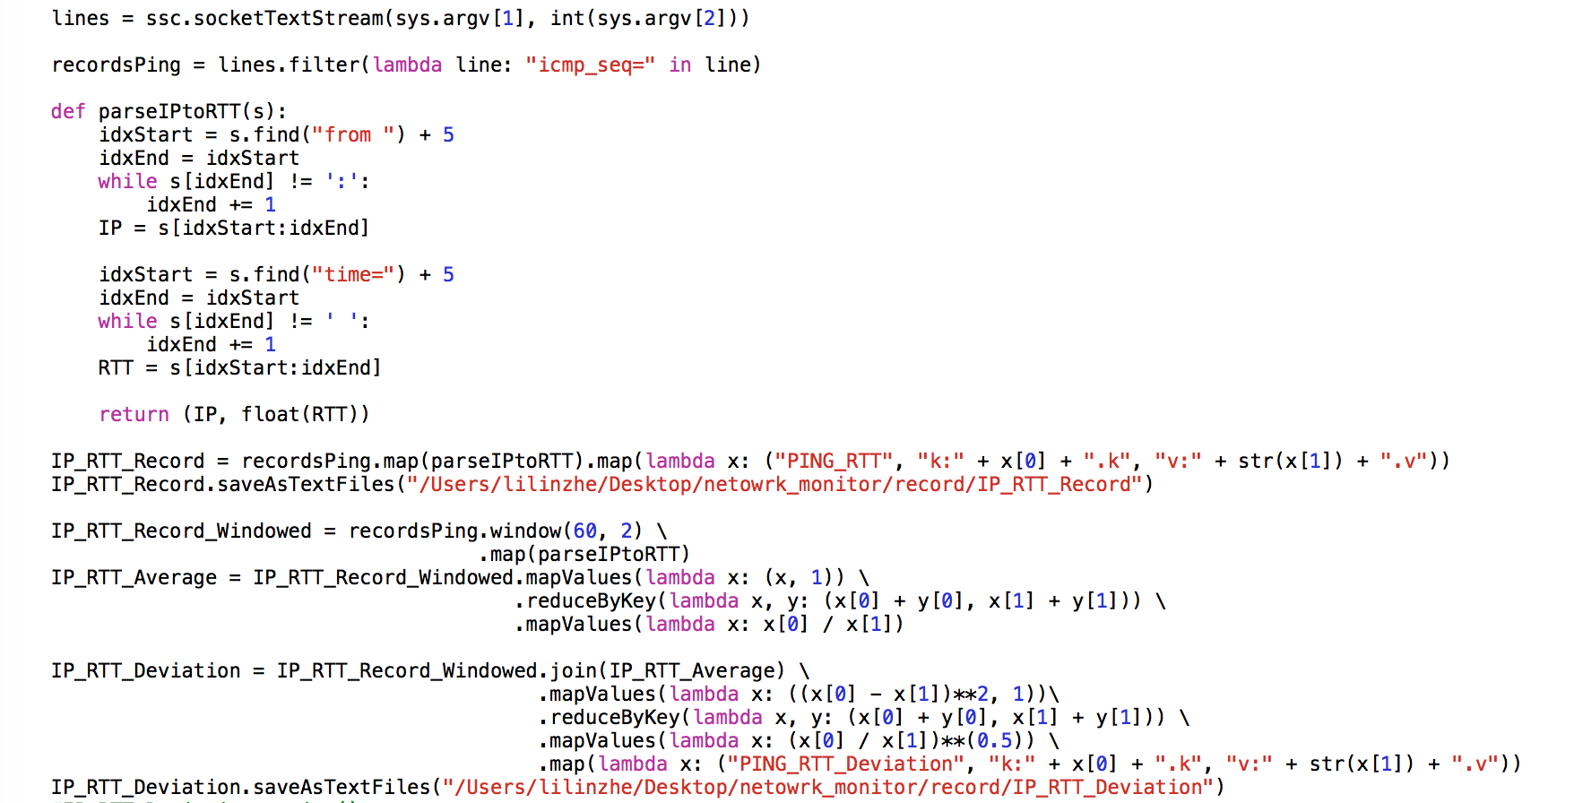
network_monitor.py:
An example to illustrate calculate deviation of round trip time

Slide 8
network_monitor.py:
lines = ssc.socketTextStream(sys.argv[1], int(sys.argv[2]))
socketTextStream
lines
PING 104.16.33.249 (104.16.33.249): 56 data bytes
64 bytes from 104.16.33.249: icmp_seq=0 ttl=58 time=16.319 ms
--- 104.16.33.249 ping statistics ---
1 packets transmitted, 1 packets received, 0.0% packet loss
round-trip min/avg/max/stddev = 16.319/16.319/16.319/0.000 ms
PING 198.11.132.250 (198.11.132.250): 56 data bytes
64 bytes from 198.11.132.250: icmp_seq=0 ttl=51 time=71.734 ms
--- 198.11.132.250 ping statistics ---
1 packets transmitted, 1 packets received, 0.0% packet loss
round-trip min/avg/max/stddev = 71.734/71.734/71.734/0.000 ms
PING 128.210.224.23 (128.210.224.23): 56 data bytes
64 bytes from 128.210.224.23: icmp_seq=0 ttl=55 time=19.355 ms
--- 128.210.224.23 ping statistics ---
1 packets transmitted, 1 packets received, 0.0% packet loss
round-trip min/avg/max/stddev = 19.355/19.355/19.355/0.000 ms
PING 149.165.180.49 (149.165.180.49): 56 data bytes
64 bytes from 149.165.180.49: icmp_seq=0 ttl=57 time=17.320 ms
……
……
……
PING 104.16.33.249 (104.16.33.249): 56 data bytes
64 bytes from 104.16.33.249: icmp_seq=0 ttl=58 time=16.319 ms
--- 104.16.33.249 ping statistics ---
1 packets transmitted, 1 packets received, 0.0% packet loss
round-trip min/avg/max/stddev = 16.319/16.319/16.319/0.000 ms
PING 198.11.132.250 (198.11.132.250): 56 data bytes
64 bytes from 198.11.132.250: icmp_seq=0 ttl=51 time=71.734 ms
--- 198.11.132.250 ping statistics ---
1 packets transmitted, 1 packets received, 0.0% packet loss
round-trip min/avg/max/stddev = 71.734/71.734/71.734/0.000 ms
PING 128.210.224.23 (128.210.224.23): 56 data bytes
64 bytes from 128.210.224.23: icmp_seq=0 ttl=55 time=19.355 ms
--- 128.210.224.23 ping statistics ---
1 packets transmitted, 1 packets received, 0.0% packet loss
round-trip min/avg/max/stddev = 19.355/19.355/19.355/0.000 ms
PING 149.165.180.49 (149.165.180.49): 56 data bytes
64 bytes from 149.165.180.49: icmp_seq=0 ttl=57 time=17.320 mss
……
……
……

Slide 9
network_monitor.py:
recordsPing = lines.filter(lambda line: "icmp_seq=" in line)
lines
recordsPing
PING 104.16.33.249 (104.16.33.249): 56 data bytes
64 bytes from 104.16.33.249: icmp_seq=0 ttl=58 time=16.319 ms
--- 104.16.33.249 ping statistics ---
1 packets transmitted, 1 packets received, 0.0% packet loss
round-trip min/avg/max/stddev = 16.319/16.319/16.319/0.000 ms
PING 198.11.132.250 (198.11.132.250): 56 data bytes
64 bytes from 198.11.132.250: icmp_seq=0 ttl=51 time=71.734 ms
--- 198.11.132.250 ping statistics ---
1 packets transmitted, 1 packets received, 0.0% packet loss
round-trip min/avg/max/stddev = 71.734/71.734/71.734/0.000 ms
PING 128.210.224.23 (128.210.224.23): 56 data bytes
64 bytes from 128.210.224.23: icmp_seq=0 ttl=55 time=19.355 ms
--- 128.210.224.23 ping statistics ---
1 packets transmitted, 1 packets received, 0.0% packet loss
round-trip min/avg/max/stddev = 19.355/19.355/19.355/0.000 ms
PING 149.165.180.49 (149.165.180.49): 56 data bytes
64 bytes from 149.165.180.49: icmp_seq=0 ttl=57 time=17.320 mss
……
……
……
64 bytes from 104.16.33.249: icmp_seq=0 ttl=58 time=16.319 ms
64 bytes from 198.11.132.250: icmp_seq=0 ttl=51 time=71.734 ms
64 bytes from 128.210.224.23: icmp_seq=0 ttl=55 time=19.355 ms
64 bytes from 149.165.180.49: icmp_seq=0 ttl=57 time=17.320 ms
64 bytes from 104.16.33.249: icmp_seq=0 ttl=58 time=16.014 ms
64 bytes from 198.11.132.250: icmp_seq=0 ttl=51 time=72.065 ms
64 bytes from 128.210.224.23: icmp_seq=0 ttl=55 time=20.388 ms
64 bytes from 149.165.180.49: icmp_seq=0 ttl=57 time=17.348 ms
64 bytes from 23.13.113.150: icmp_seq=0 ttl=54 time=31.199 ms
64 bytes from 208.82.238.129: icmp_seq=0 ttl=52 time=62.360 ms
64 bytes from 106.48.13.33: icmp_seq=0 ttl=49 time=67.665 ms
64 bytes from 103.23.108.200: icmp_seq=0 ttl=236 time=221.909 ms
64 bytes from 106.48.14.90: icmp_seq=0 ttl=52 time=26.083 ms
64 bytes from 149.165.180.17: icmp_seq=0 ttl=57 time=17.159 ms
64 bytes from 216.58.216.201: icmp_seq=0 ttl=56 time=24.659 ms
64 bytes from 216.58.192.129: icmp_seq=0 ttl=55 time=24.586 ms
64 bytes from 192.229.163.158: icmp_seq=0 ttl=58 time=12.725 ms
64 bytes from 149.165.180.34: icmp_seq=0 ttl=57 time=17.450 ms
……
……
……

Slide 10
network_monitor.py:
IP_RTT_Record = recordsPing.map(parseIPtoRTT)
recordsPing
IP_RTT_Record
64 bytes from 104.16.33.249: icmp_seq=0 ttl=58 time=16.319 ms
64 bytes from 198.11.132.250: icmp_seq=0 ttl=51 time=71.734 ms
64 bytes from 128.210.224.23: icmp_seq=0 ttl=55 time=19.355 ms
64 bytes from 149.165.180.49: icmp_seq=0 ttl=57 time=17.320 ms
64 bytes from 104.16.33.249: icmp_seq=0 ttl=58 time=16.014 ms
64 bytes from 198.11.132.250: icmp_seq=0 ttl=51 time=72.065 ms
64 bytes from 128.210.224.23: icmp_seq=0 ttl=55 time=20.388 ms
64 bytes from 149.165.180.49: icmp_seq=0 ttl=57 time=17.348 ms
64 bytes from 23.13.113.150: icmp_seq=0 ttl=54 time=31.199 ms
64 bytes from 208.82.238.129: icmp_seq=0 ttl=52 time=62.360 ms
64 bytes from 106.48.13.33: icmp_seq=0 ttl=49 time=67.665 ms
64 bytes from 103.23.108.200: icmp_seq=0 ttl=236 time=221.909 ms
64 bytes from 106.48.13.33: icmp_seq=0 ttl=52 time=26.083 ms
64 bytes from 149.165.180.17: icmp_seq=0 ttl=57 time=17.159 ms
64 bytes from 216.58.216.201: icmp_seq=0 ttl=56 time=24.659 ms
64 bytes from 216.58.192.129: icmp_seq=0 ttl=55 time=24.586 ms
64 bytes from 192.229.163.158: icmp_seq=0 ttl=58 time=12.725 ms
64 bytes from 149.165.180.34: icmp_seq=0 ttl=57 time=17.450 ms
……
……
……
(104.16.33.249, 16.319)
(198.11.132.250, 71.734)
(128.210.224.23, 19.355)
(149.165.180.49, 17.320)
(104.16.33.249, 16.014)
(198.11.132.250, 72.065)
(128.210.224.23, 20.388)
(149.165.180.49, 17.348)
(23.13.113.150, 31.199)
(208.82.238.129, 62.360)
(106.48.13.33, 67.665)
(103.23.108.200, 221.909)
(106.48.13.33, 26.083)
(149.165.180.17, 17.159)
(216.58.192.129, 24.586)
(192.229.163.158, 12.725)
(149.165.180.34, 17.450)
……
……
……

Slide 11
network_monitor.py:
IP_RTT_Average = IP_RTT_Record.mapValues(lambda x: (x, 1)) \
.reduceByKey(lambda x, y: (x[0] + y[0], x[1] + y[1])) \
.mapValues(lambda x: x[0] / x[1])
IP_RTT_Record
IP_RTT_Average
(104.16.33.249, 16.319)
(198.11.132.250, 71.734)
(128.210.224.23, 19.355)
(149.165.180.49, 17.320)
(104.16.33.249, 16.014)
(198.11.132.250, 72.065)
(128.210.224.23, 20.388)
(149.165.180.49, 17.348)
(23.13.113.150, 31.199)
(208.82.238.129, 62.360)
(106.48.13.33, 67.665)
(103.23.108.200, 221.909)
(106.48.13.33, 26.083)
(149.165.180.17, 17.159)
(216.58.192.129, 24.586)
(192.229.163.158, 12.725)
(149.165.180.34, 17.450)
……
……
……
(104.16.33.249, (16.319, 1))
(198.11.132.250, (71.734, 1))
(128.210.224.23, (19.3551 ,1))
(149.165.180.49, (17.320, 1))
(104.16.33.249, (16.014, 1))
(198.11.132.250, (72.065, 1))
(128.210.224.23, (20.388, 1))
(149.165.180.49, (17.348, 1))
(23.13.113.150, (31.199, 1))
(208.82.238.129, (62.360, 1))
(106.48.13.33, (67.665, 1))
(103.23.108.200, (221.909, 1))
(106.48.13.33, (26.083, 1))
(149.165.180.17, (17.159, 1))
(216.58.192.129, (24.586, 1))
(192.229.163.158, (12.725, 1))
(149.165.180.34, (17.450, 1))
……
……
……
(104.16.33.249, (16.319, 2))
(198.11.132.250, (71.734, 2))
(128.210.224.23, (19.3551 ,2))
(149.165.180.49, (17.348, 4))
(23.13.113.150, (31.199, 1))
(208.82.238.129, (62.360, 1))
(106.48.13.33, (67.665, 2))
(103.23.108.200, (221.909, 1))
(216.58.192.129, (24.586, 1))
(192.229.163.158, (12.725, 1))
……
……
……
(104.16.33.249, 8.1595)
(198.11.132.250, 35.867)
(128.210.224.23, 9.67755)
(149.165.180.49, 4.337)
(23.13.113.150, 31.199)
(208.82.238.129, 62.360)
(106.48.13.33, 33.8325)
(103.23.108.200, 221.909)
(216.58.192.129, 24.586)
(192.229.163.158, 12.725)
……
……
……

Slide 12
network_monitor.py:
IP_RTT_Deviation = IP_RTT_Record.join(IP_RTT_Average) \
.mapValues(lambda x: ((x[0] - x[1])**2, 1))\
.reduceByKey(lambda x, y: (x[0] + y[0], x[1] + y[1])) \
.mapValues(lambda x: (x[0] / x[1])**(0.5))
IP_RTT_Record
IP_RTT_Deviation
(104.16.33.249, 16.319)
(198.11.132.250, 71.734)
(128.210.224.23, 19.355)
(149.165.180.49, 17.320)
(104.16.33.249, 16.014)
(198.11.132.250, 72.065)
(128.210.224.23, 20.388)
(149.165.180.49, 17.348)
(23.13.113.150, 31.199)
(208.82.238.129, 62.360)
(106.48.13.33, 67.665)
(149.165.180.17, 17.159)
……
……
……
(104.16.33.249, (16.319, 8.1595))
(198.11.132.250, (71.734, 35.867))
(128.210.224.23, (19.355, 9.67755))
(149.165.180.49, (17.320, 4.337))
(104.16.33.249, (16.014, 8.1595))
(198.11.132.250, (72.065, 35.867))
(128.210.224.23, (20.388, 9.67755))
(149.165.180.49, (17.348, 4.337))
(23.13.113.150, (31.199, 31.199))
(208.82.238.129, (62.360, 62.360))
(106.48.13.33, (67.665, 33.8325))
(149.165.180.17, (17.159, 4.337))
……
……
……
(104.16.33.249, (66.577, 1))
(198.11.132.250, (1286.442, 1))
(128.210.224.23, (93.653, 1))
(149.165.180.49, (168.558, 1))
(104.16.33.249, (66.577, 1))
(198.11.132.250, (1286.442, 1))
(128.210.224.23, (93.653, 1))
(149.165.180.49, (168.558, 1))
(23.13.113.150, (0, 1))
(208.82.238.129, (0, 1))
(106.48.13.33, (1144.638, 1))
(149.165.180.17, (168.558, 1))
……
……
……
(104.16.33.249, (113.153, 2))
(198.11.132.250, (2572.88, 2))
(128.210.224.23, (187.306, 2))
(149.165.180.49, (674.232, 4))
(23.13.113.150, (0, 1))
(208.82.238.129, (0, 1))
(106.48.13.33, (2289.276, 2))
……
……
……
(104.16.33.249, 7.521)
(198.11.132.250, 35.867)
(128.210.224.23, 9.677)
(149.165.180.49, 12.893)
(23.13.113.150, 0)
(208.82.238.129, 0)
(106.48.13.33, 33.832)
……
……
……

Slide 13
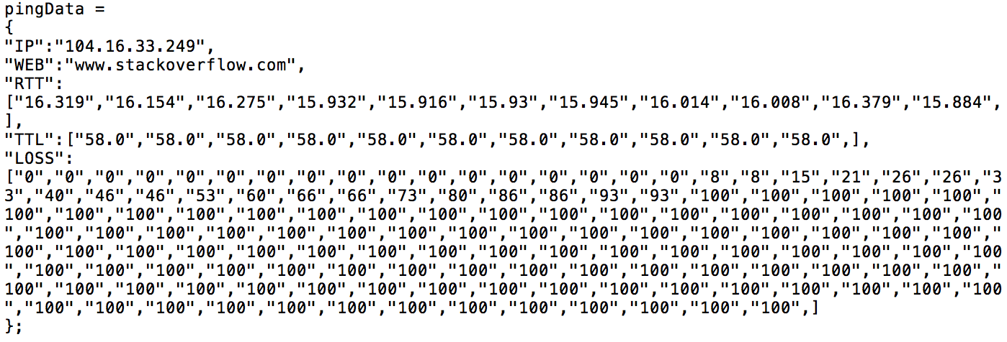
control.cpp:
control.cpp can give alert when the results from spark streaming indicates that there may be a potential network problem, such as, link failure or link congestion.
Fig 2: alert example
Then, output a .json file that contain round trip time, time-t-live, and loss rate information of the problematic link.
Fig 3: .json example

Slide 14
chart.html:
Base on .json file, chart.html dynamically show those information on a graph.
Fig 4: graph for link failure case

Slide 15
CONTRIBUTIONS:
Feiyi Xu
Create Java Script code for data visualization
Linzhe Li
Wrote C++ and bash script to do data collection
Implemented Spark Streaming for data analysis using Python
Improved data visualization functionality assisted by CanvasJS
Tested system performance by writing some test cases
Code can be found on GitHub:
https://github.com/MrBruceLee/NetworkMonitor.git

